Slide 1
nlmixr2: an open-source package for pharmacometric modelling in R
Course material nlmixr2 PMxAfrica 2025 Rik Schoemaker, PhD 07 August 2025

Slide 2
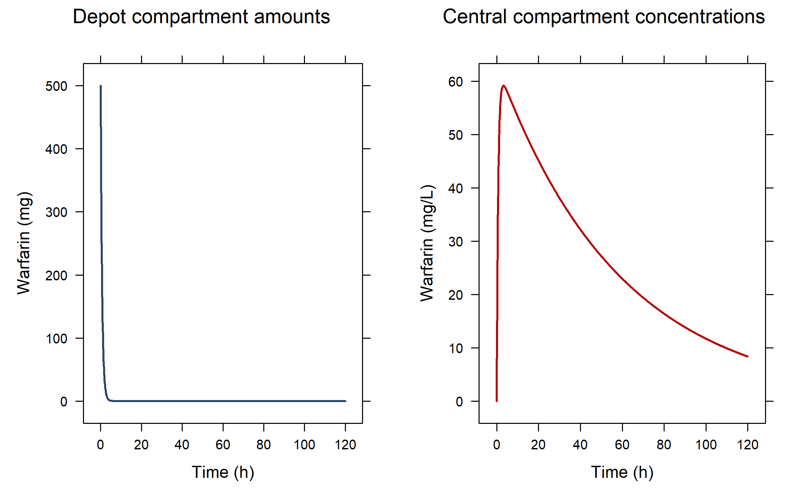
Simulation of a single (warfarin concentration) curve with a single dose

Slide 3
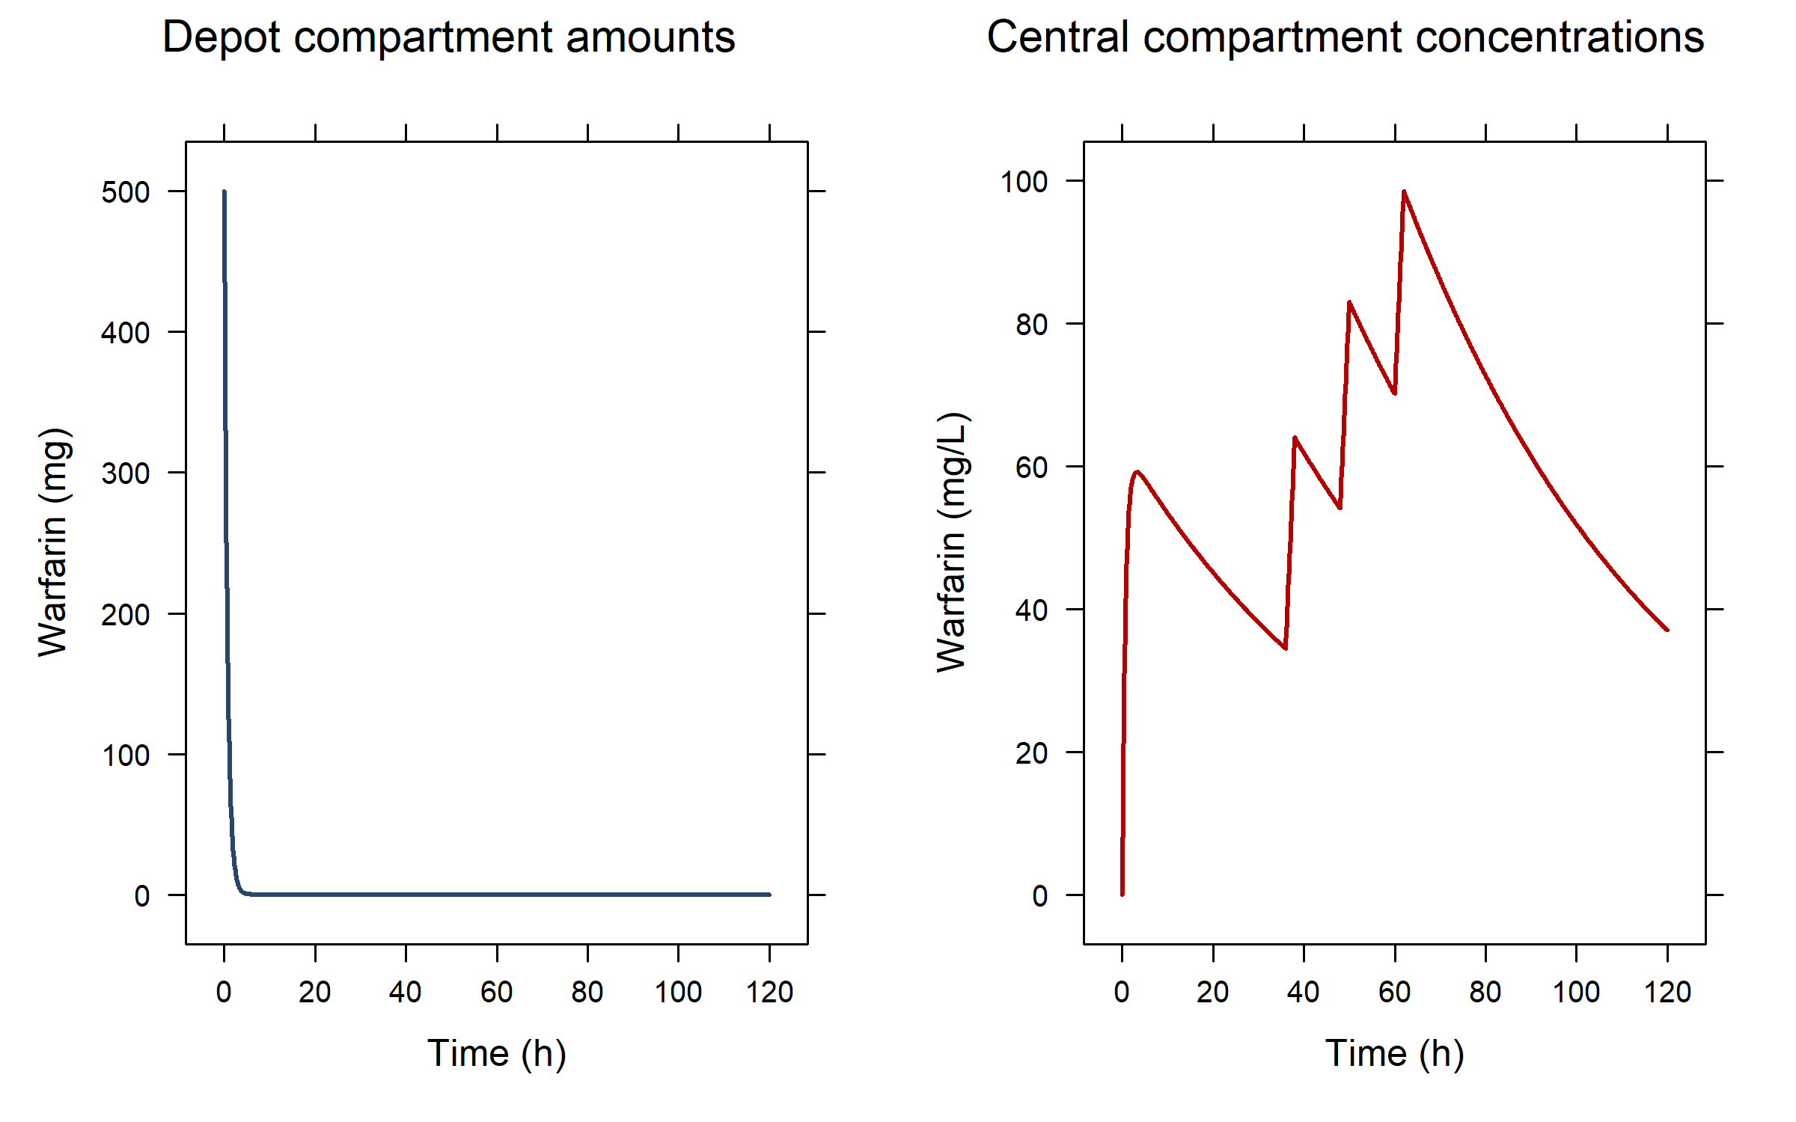
...and simulating three additional infusions in the central compartment

Slide 4
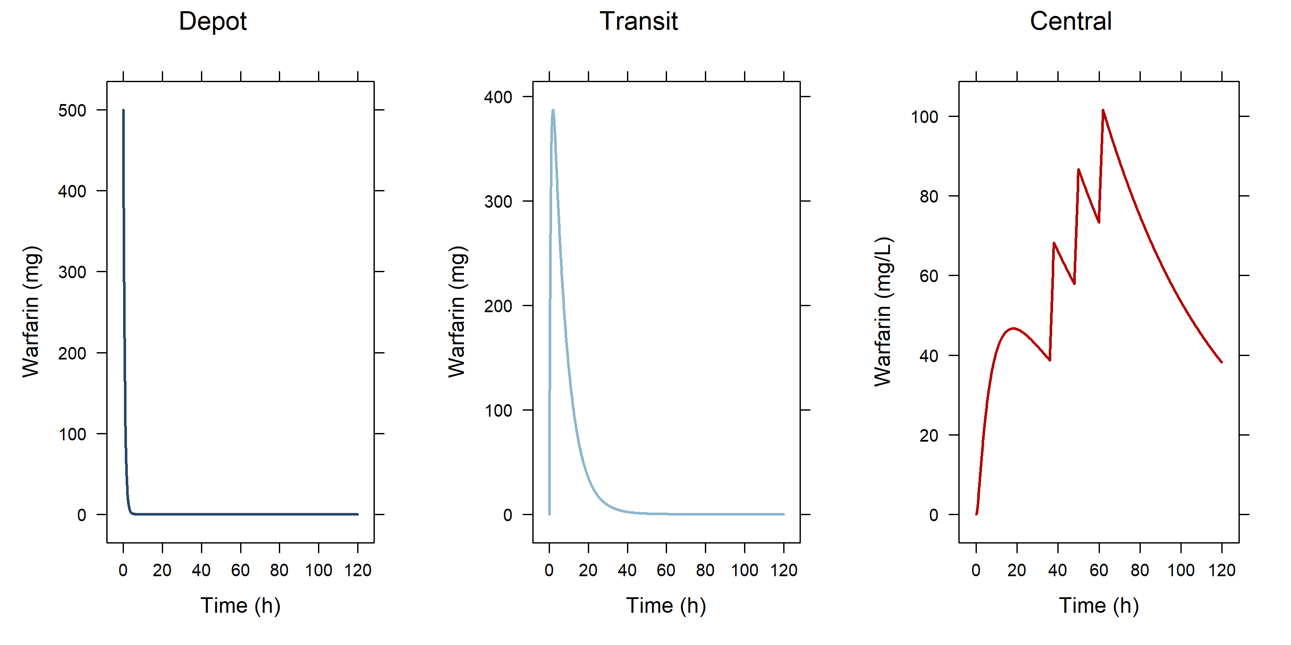
...adding a transit compartment between depot and central

Slide 5
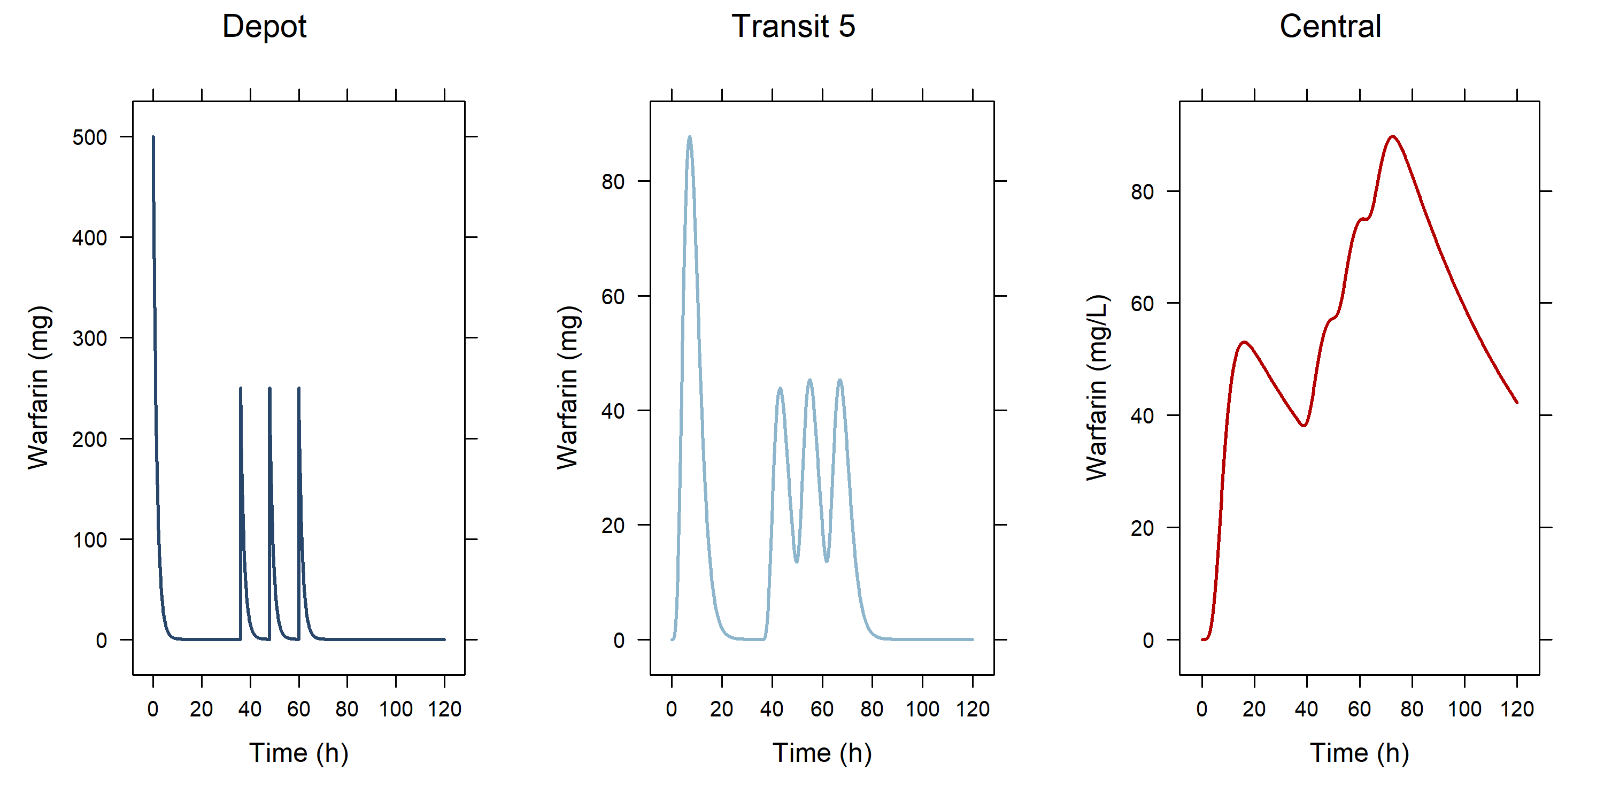
...adding 5 transit compartments between depot and central and giving 4 bolus doses in the 1st compartment

Slide 6
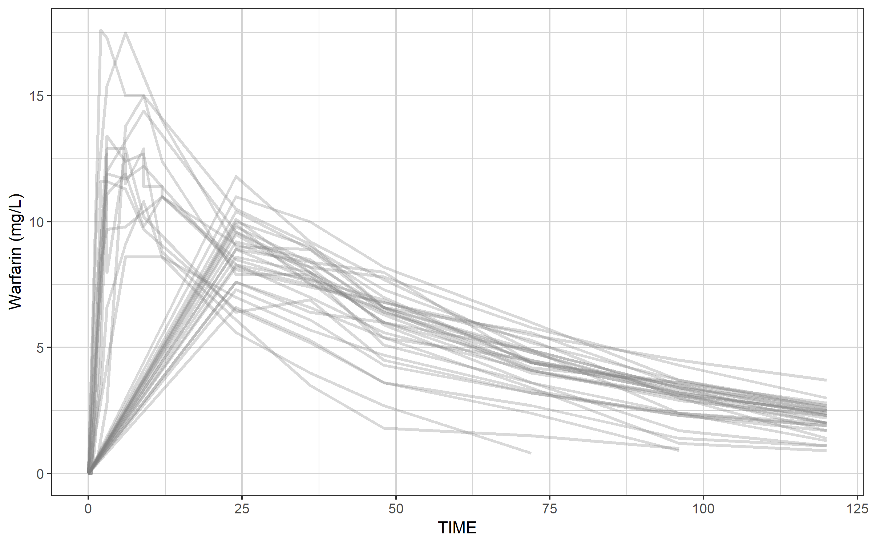
Our warfarin data file: a ggplot to provide an impression

Slide 7
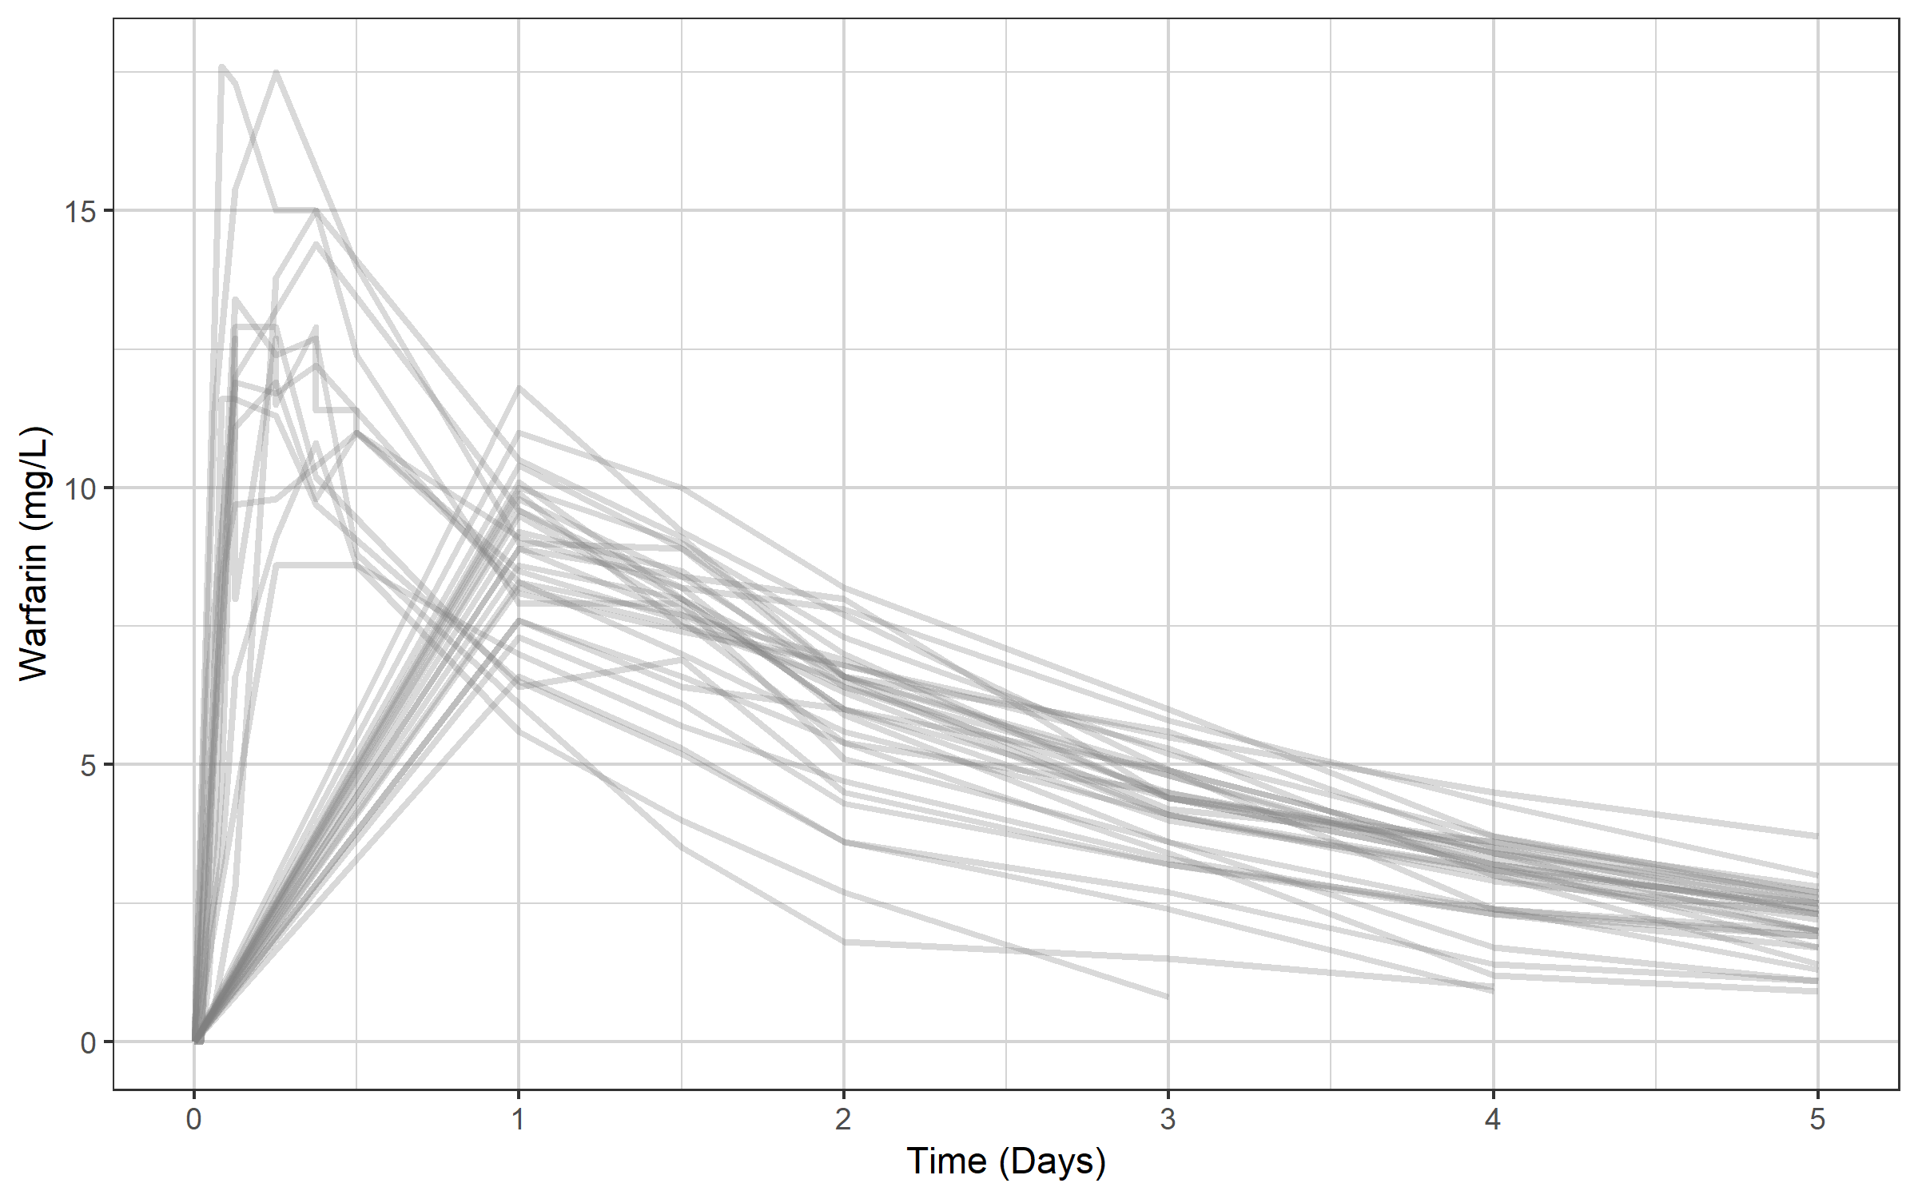
Change the x-axis from hours to days and add a proper label using the xgx helper xgx_scale_x_time_units(units_dataset = "hours", units_plot = "days")

Slide 8
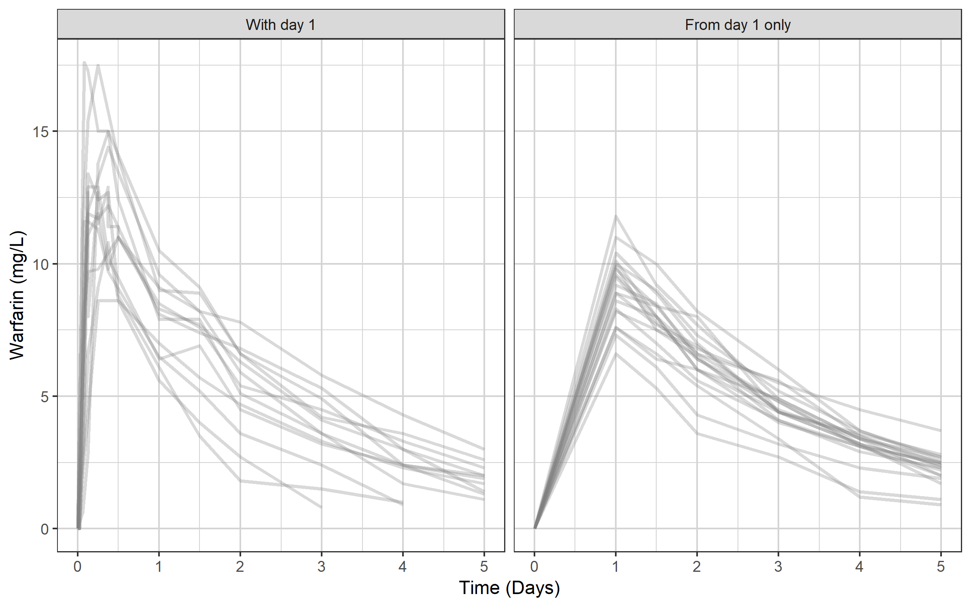
The data set has two types of profiles

Slide 9
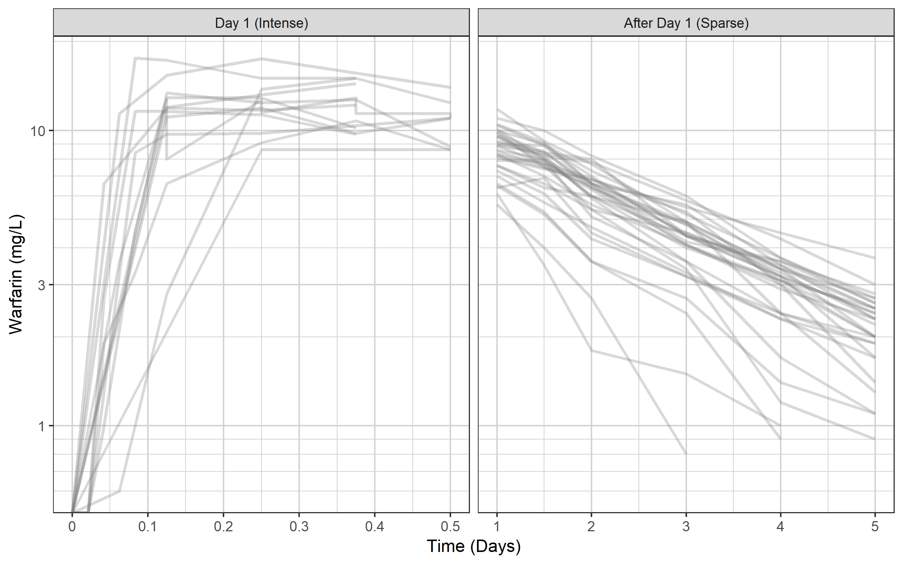
Switch to semi-log scale using xgx helper xgx_scale_y_log10() Any clues to what model we should use?

Slide 10
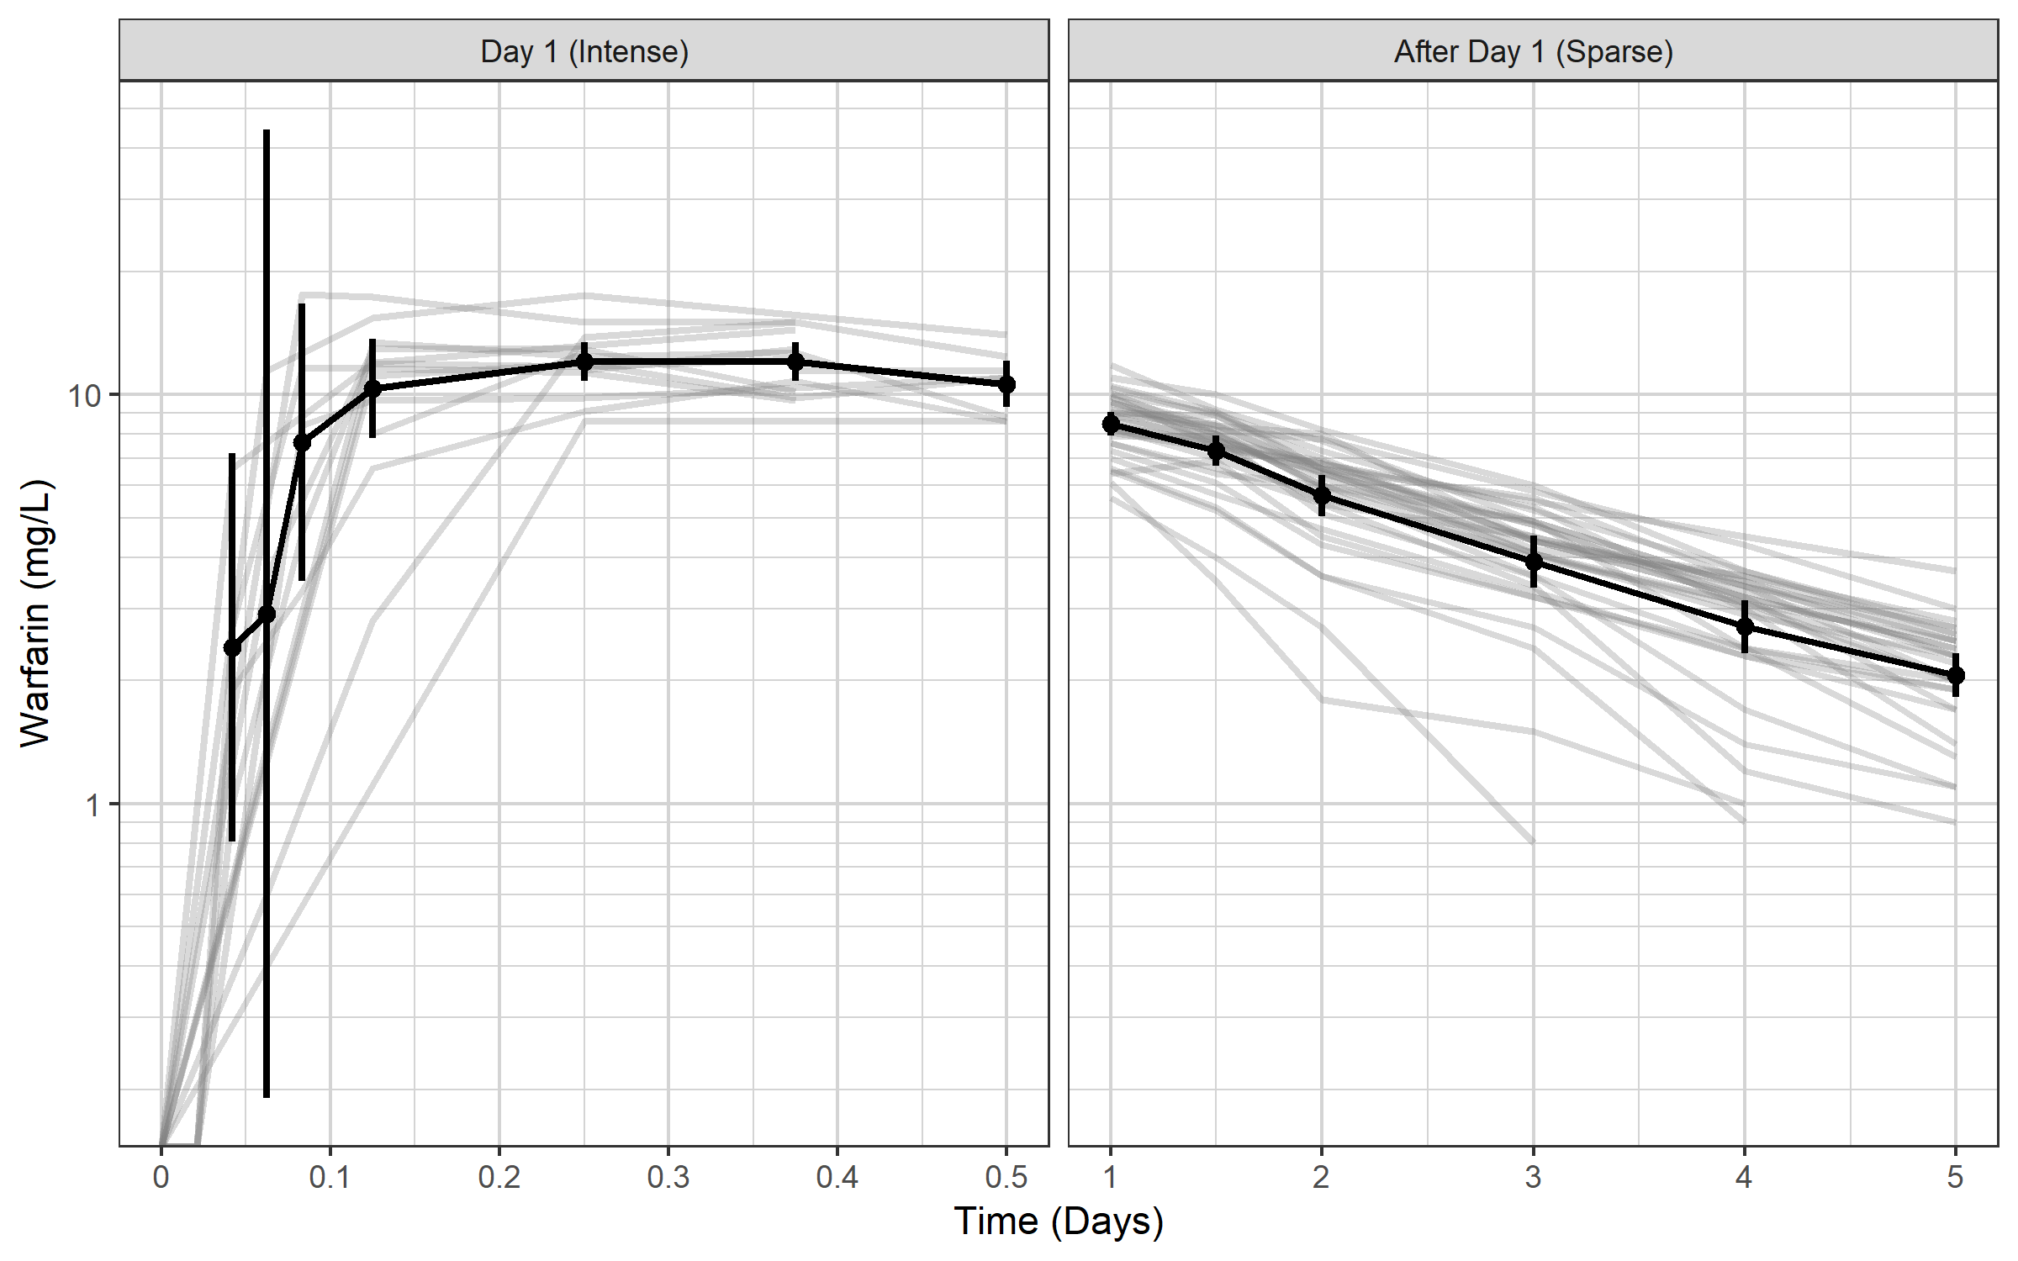
xgx can also add nice summary information if data has nominal times: summaries of mean plus 95% CI xgx_geom_ci(aes(x = TIME, color = NULL, group = NULL, shape = NULL), conf_level = 0.95)

Slide 11
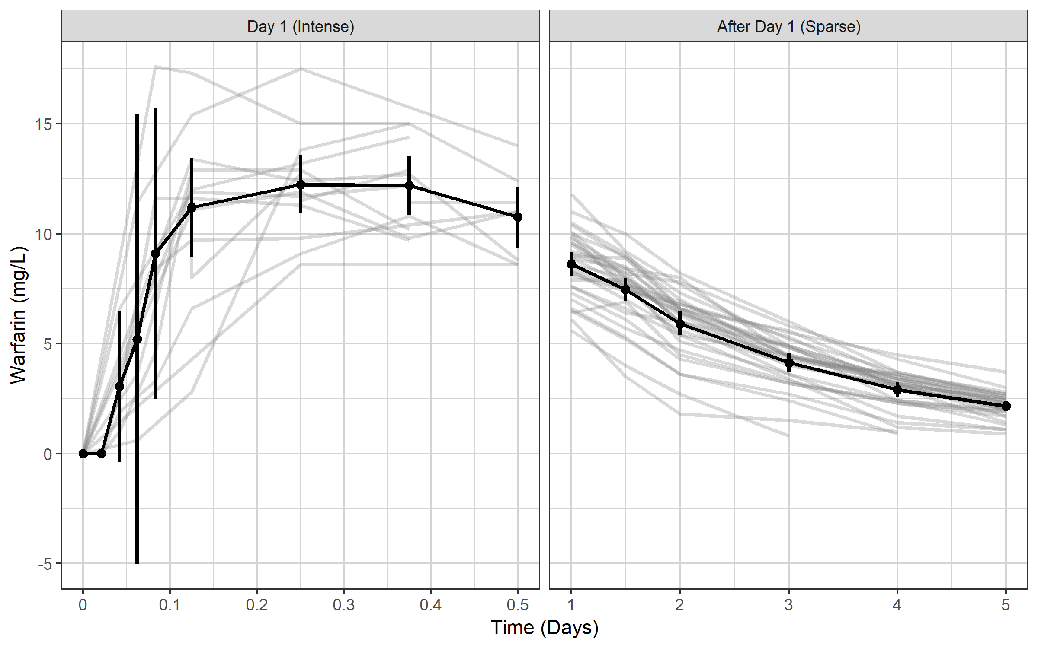
On linear scale this would result in a CI crossing zero because CIs are assumed symmetrical

Slide 12
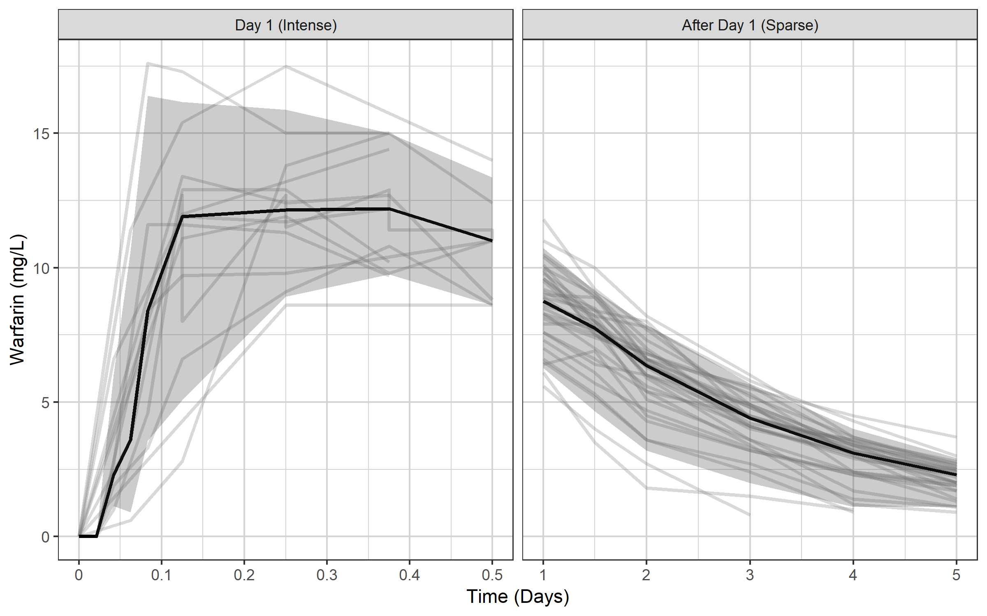
...so perhaps a median and 95% of the data would be more suitable xgx_geom_pi(aes(x = TIME, color = NULL, group = NULL, shape = NULL)

Slide 13
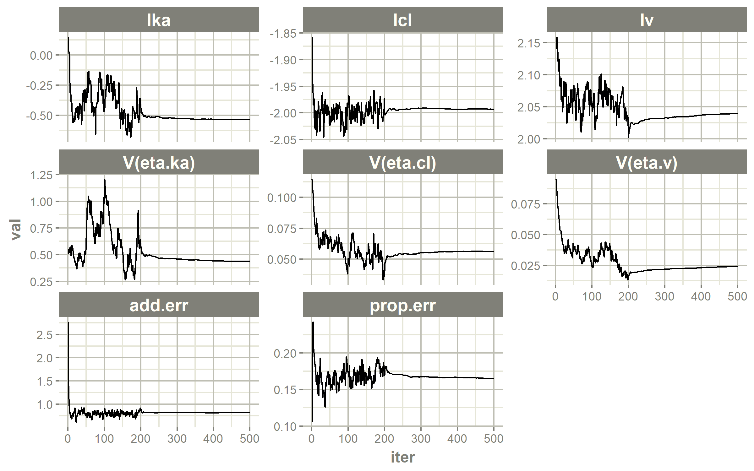
Traceplot for SAEM parameter estimates using nlmixr2 command

Slide 14
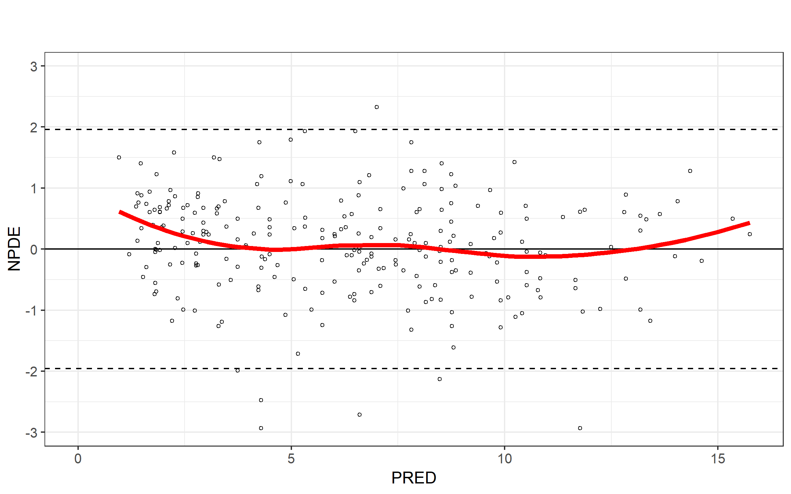
NPDE vs PRED plot using ggPMX ctr %>% pmx_plot_npde_pred or pmx_plot_npde_pred(ctr)

